Slide 1
Religion, CompetiTION, europe: WHICH COMbINATION ?
François H. BRIARD
French Supreme Court Attorney
President of the VERGENNES SOCIETY
AEI Transatlantic Forum
Hamburg, June 10-11 2014

Slide 2
RELIGION AN COMPETITION
3 possible scopes
RELIGION v/ GOVERNMENT: power, control, freedom of religion, Caesar and God, problematic relationship and pacified with secularization.
RELIGION v/ ECONOMY: business ethics, economic efficiency,
RELIGION v/ RELIGION: relationship between Gods and between religions…

Slide 3
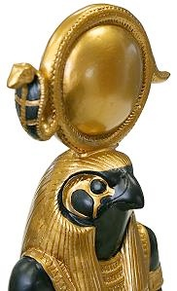
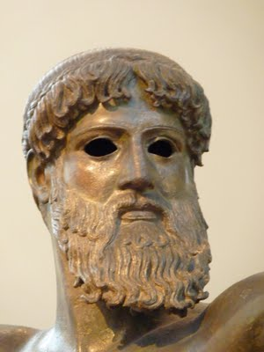
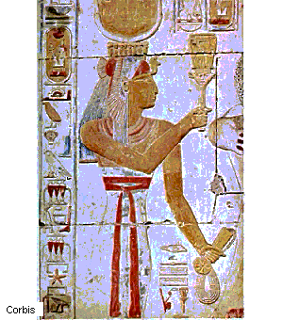
COMPETITION AND RELIGION: AN OLD STORY
Since Antiquity, religions had to compete to increase their devotees: Egyptian, Greek, Roman divinities, all knew that necessity: being the winner and compete with others.
Who was the best, the most efficient, the greatest ?.... Over 2000 years, faith and imagination of humanity had no limit on free market of religion…

Slide 4
Then came the three monotheist religions, each of them
tempted by what modern economists would call
« abusing dominant position »
one faith, one God, one only God.

Slide 5
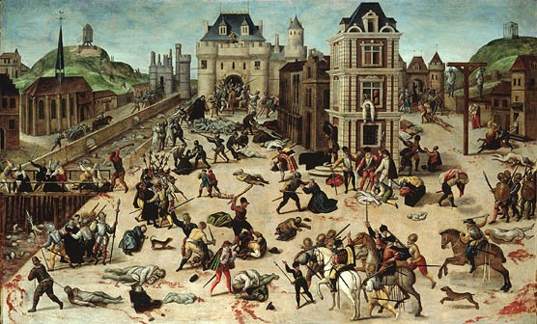
Did monotheism mean the end of competition ? Actually , the religious European history was a bloody one because no competition was accepted in faith.

Slide 6
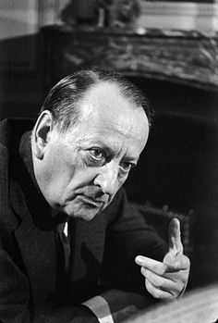
« The XXIth Century will be religious
or it will not be at all »
André MALRAUX, 1976

Slide 7
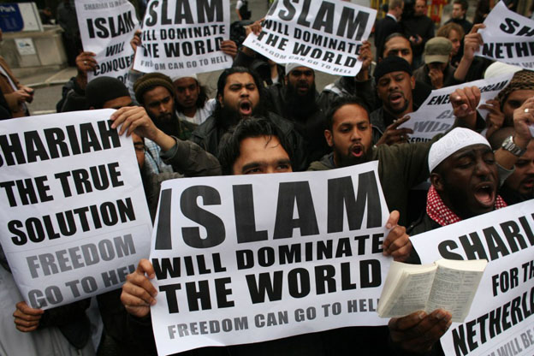
MALRAUX was right: the starting XXIth Century looks dominated
by religious extremism and religious offensive.
Business of religion is booming;
Religious extremism is flourishing;
All of that in a global world dominated by a God named money…

Slide 8
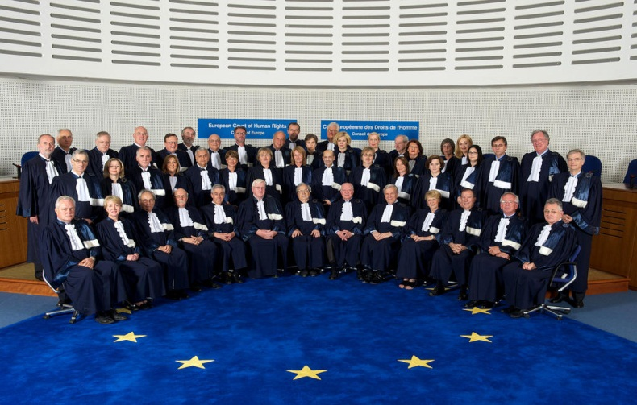
GLOBAL EUROPEAN RULES FOR RELIGIOUS COMPETITION
ECJ in Luxemburg deals with the religion of competition
ECHR in Strasbourg deals with religious competition
The main legal frame is now given by the ECHR: laws of 47 European countries (820 million inhabitants) have to be compatible with the ECHR and the case-law of the Court of Strasbourg.
Three basic rules regarding competition and religion

Slide 9
RULE 1
Pluralism is the modern name of religious competition: it is related to freedom of thought, conscience and religion protected by article 9 of the ECHR. It is one of the foundations of a "democratic society", one of the most vital elements that go to make up the identity of believers and their conception of life, also a precious asset for atheists, agnostics, sceptics and the unconcerned. Pluralism is one of the pillars of a democratic society, it has been “dearly won over the centuries”.
Questions:
How far
must pluralism be
promoted ?
Should pluralism be
combined with competition
law ?

Slide 10
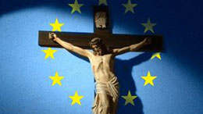
RULE 2
Dominant religion may be promoted by States in public space (class rooms) on behalf of the margin of appreciation and as a matter of culture (LAUTSI, March 18,2011): Its significance is not only political and legal, but also religious. It is emblematic of the cultural crisis in Western Europe regarding religion. Twenty-one State parties to the European Convention on Human Rights, in an unprecedented move, joined Italy to reassert the legitimacy of the public display of Christian symbols in European society. The Court finally recognized, in substance, that in countries of Christian tradition, Christianity enjoys a special social legitimacy that distinguishes it from other philosophical and religious belief systems. In other words, because Italy is a country of Christian tradition, Christian symbols may legitimately enjoy greater visibility in Italian society than other religious or ideological symbols.

Slide 11
RULE 3
Proselytism, which is the main face of religious competition (converting others) may be limited by European States (even forbidden like in Greece): LARISSIS, february 24, 1998; KOKKINAKIS, May 25,1993, Jehovah Witness arrested more than 60 times for proselytism towards Orthodox Christians)): one should make a difference between proper and improper proselytism.; “true evangelism” v/ improper pressure on people (advantages, brainwash, violence).

Slide 12
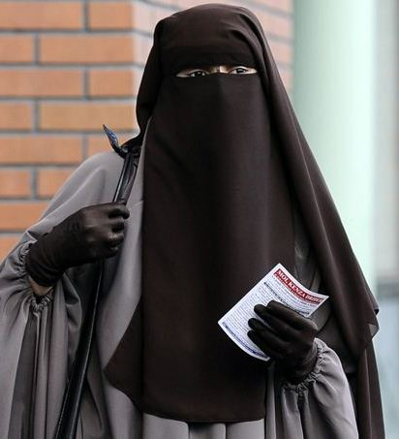
Another issue is the role of Government in religious regulation.
We know how to regulate economy through anti-trust laws. How to regulate religion ?
There is still a big gap between the North-American view and the European one. According to the First Amendment to the US Constitution, proselytism and competition are related to religious freedom and free speech. Government should not intervene in this matter. From the European point of view, probably because Europe was devastated by ideologies during the XXth Century, and also because of the growth of radical Islam, we do believe that Government has a mission to protect people against religious pressure and to preserve unity in our societies.
The best example of such a view is the French law banning face concealment.

Slide 13
CONCLUSION
Religious competition (pluralism) must be promoted by Governments and protected by laws: it should apply to all faiths, cults and beliefs, including atheism.
Religious abuse of a dominant position should be prohibited but dominant position should be lawful, especially as a matter of culture
Agressive behaviors to obstruct competitors in the religious market or to force buying faiths must be prosecuted.

